Slide 1
AI-Powered QA Bug Reporting Workflow
Implementation & Design Overview (n8n)

Slide 2
Introduction
Automates QA bug reporting workflow end-to-end
Converts raw issue description to professional bug report
Integrates AI, Google Sheets, Slack, Jira, and Vector DB

Slide 3
Objective
Ensure structured, high-quality bug reports
Reduce manual bug reporting effort
Detect duplicate bugs automatically
Automate approval & ticketing
Seamless integration with team tools

Slide 4
🔍 Problem Statement
In modern QA workflows, bug reporting suffers from several inefficiencies:
❌ Unstructured bug descriptions from users
❌ Missing critical details (environment, steps, severity)
❌ Duplicate bug submissions wasting team effort
❌ Manual triaging and validation delays
❌ Lack of centralized intelligence for historical bugs
These issues lead to:
Increased QA overhead
Slower release cycles
Poor communication between QA, Dev, and Product teams

Slide 5
💡 Proposed Solution
An AI-powered automated bug reporting system that:
✅ Key Capabilities
Converts raw user input into structured QA bug reports
Uses LLM (OpenAI) for intelligent analysis and formatting
Detects duplicate bugs using vector embeddings
Automates approval workflow via Slack
Integrates with:
📊 Google Sheets (tracking)
🎫 Jira (issue creation)
Stores historical bugs in a Vector Database for semantic search

Slide 6
🎯 Expected Outcome
Expected Outcome:
Area | Improvement
Bug Quality | +80% structured & complete reports
Duplicate Reduction | -60% duplicate submissions
QA Efficiency | +50% faster triaging
Time to Ticket | Reduced from minutes → seconds
Collaboration | Real-time Slack approvals

Slide 7
Benefits
Eliminates manual formatting errors
Standardized bug reports
Real-time duplicate detection
Streamlined approvals and notifications
Centralized storage and analytics

Slide 8
🔐 Security & Data Handling
🔒 Authentication
OAuth2 used for:
Google Sheets
Slack
Jira
🔑 API Security
Secure credential storage in n8n
No hardcoded secrets
📦 Data Privacy
Sensitive data is:
Not exposed externally
Processed within controlled workflows
🧠 AI Safety
Controlled prompt engineering
Strict output formatting rules

Slide 9
System Overview
Architecture Overview
User Input: Captured via n8n Chat Trigger
AI Agent: Generates structured bug report
Report Parser: Extracts metadata and steps
Duplicate Detection: Embeddings + similarity evaluation
Storage: Vector DB + Google Sheets
Notifications: Slack alerts for approval, duplicate, approved, or rejected bugs
Issue Tracking: Jira ticket creation

Slide 10
System Overview
Architecture Diagram
User Input --> AI Agent Bug Reporting-->Report Parser --> Format Search Query --> Evaluate Similarity --> Is Duplicate?
Is Duplicate? --> Yes --> Notify Duplicate (Slack)
Is Duplicate? --> No --> Prepare Bug for Storage --> Generate Storage Embedding-->Store Bug in VectorDB --> Prepare Storage Document -->
Update Sheet with Jira ID --> Code in JavaScript --> Create Jira Issue --> Send Slack Message (Approved)
Bug Rejected (Slack)

Slide 11
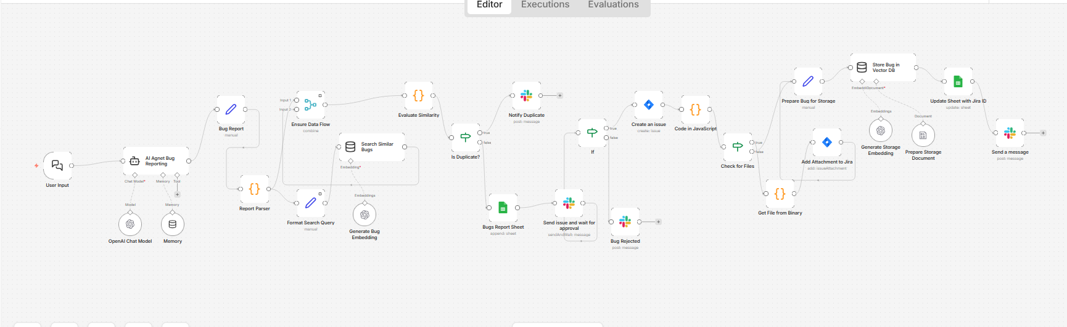
System Overview

Slide 12
Integration & Tools
n8n: Workflow automation
OpenAI: Text generation, embeddings
Slack: Team notifications and approval
Google Sheets: Centralized bug tracking
Jira: Issue tracking & ticket creation
Vector DB: Duplicate detection & retrieval

Slide 13
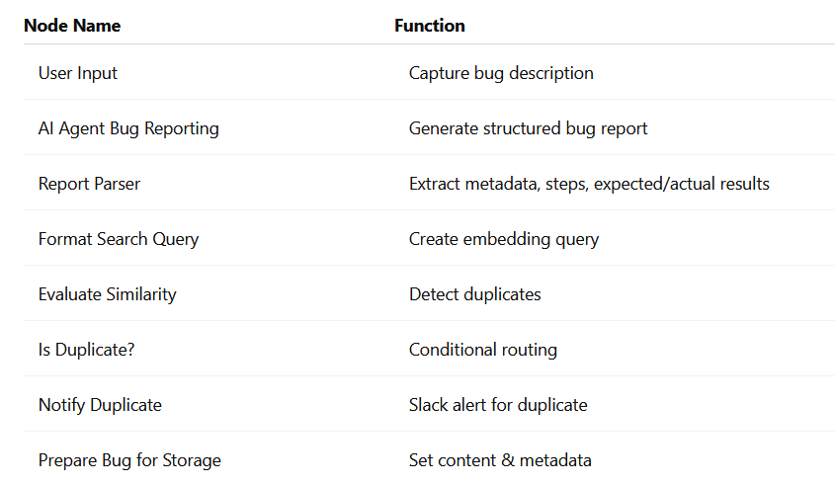
Workflow Components Table

Slide 14
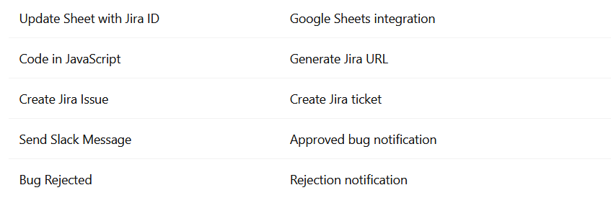
Workflow Components Table

Slide 15
Conditional Logic
IF the reported issue is Duplicate (Already reported):
-> Send Notification with the JIRA# if exists.
IF the reported issue is New then:
IF approved:
→ Create Jira ticket
IF rejected:
→ Send rejection notification

Slide 16
Jira Integration
Auto-create tickets
Map fields following the QA Standard Report.
File Upload Support:
Users can attach screenshots or videos as evidence, which are linked directly to the JIRA ticket for full traceability.

Slide 17
Notifications
Slack confirmation on approval with ticket ID + URL
Rejection alerts
Slack Notification if the reported issue is duplicated “already in the Google sheet” shared its JIRA# if any.

Slide 18
Testing & Validation
Validate inputs
Test approval/rejection
Verify Jira creation
Check missing fields
Validate if the bug reported before “Duplicated”

Slide 19
Troubleshooting
• Empty fields → check parser
• Jira errors → validate fields
• Slack issues → check wait node
• Check duplicate -> Use DB and Mem

Slide 20
Best Practices
Use strict AI prompts
Secure credentials
Monitor logs
Add retry logic
Aviod Duplicate
Keep the reporter always updated for any status

Slide 21
Conclusion
Fully automated QA lifecycle:
Standardized
Efficient
Traceable
Scalable

Slide 22
Demo & Ref
Feel free to review the documentation and demo videos:
https://drive.google.com/drive/folders/1qRpIpxGNBEyeMOILkOBqZmB83FRJi2t1

